Slide 1
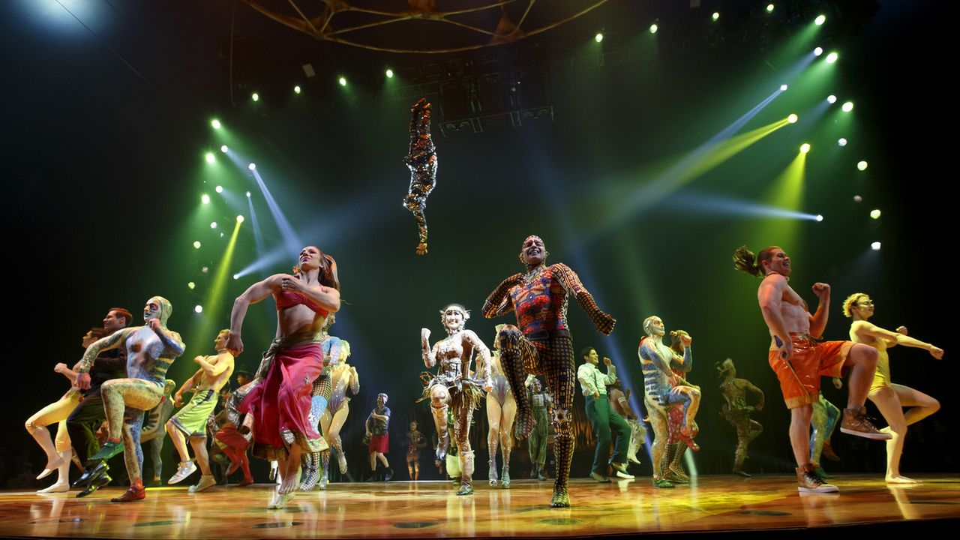
Cirque du Soleil Business Strategy Proposition
October 15, 2020
I.Cohen, T. Kreutschy, A. Pannequin, Y. Stehle, D. Szenes, M. Wicki

Slide 2




Dangers with your actual business model
Negotiating power
Relationship specific investment
Incompleteness of contract
Hold Up

Slide 3
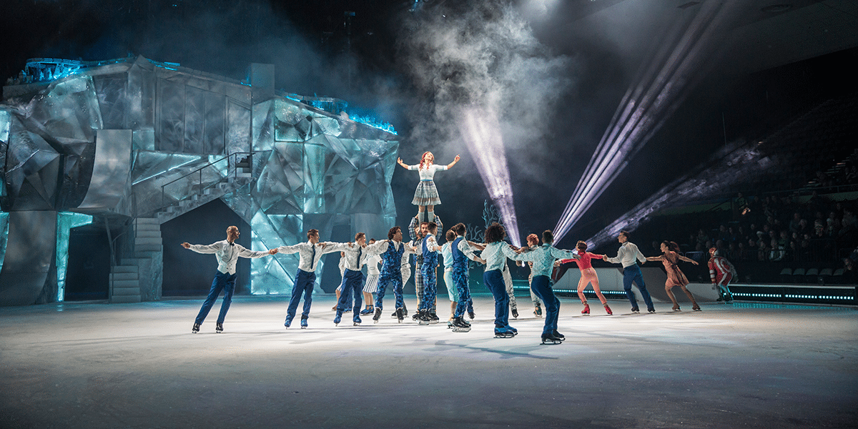
Advantages with your actual business model
Share of financial risks
Strategic locations → customer’s loyalty
“Open-book” contract → creativity freedom

Slide 4
Recommendations concerning your business model
Creating its own venues → Vertical integration
Difficulties to find a strategic location
Very costly solution
Competition
No more hold-up problems
Keep your actual model
Keep your actual model

Slide 5
Internal Organization
Old policy
New policy
High Creativity
Standardization of the creative process
Relation-specific investments
Creativity due to their organization
Creativity and thus success of shows came from only certain people 🡪 risk of hold-up
Could lead to failure of the general vision

Slide 6
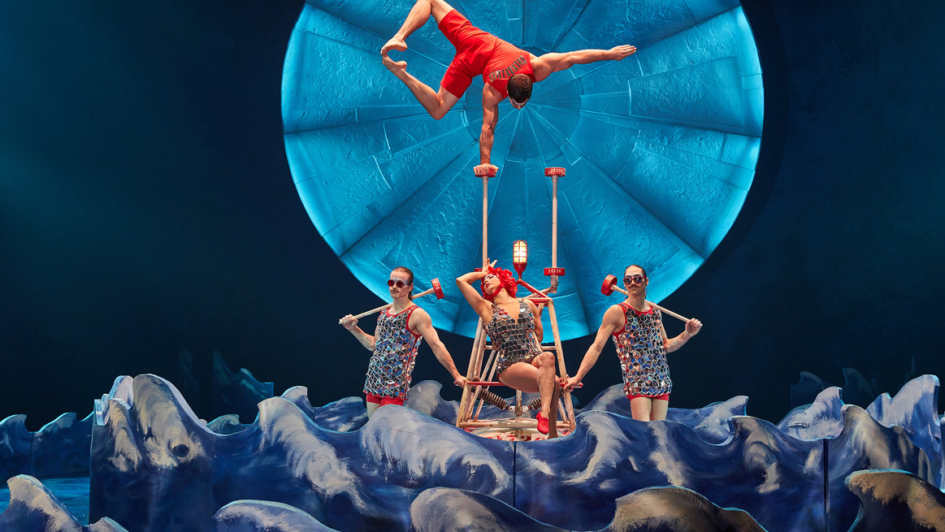
Recommendations and
New strategies
INTERNAL
Operations management → Project management
Rotation system
Cross-functional team
EXTERNAL
Creating relationships with outdoor artistic designers
Function of “consultants” to avoid authority problem

Slide 7
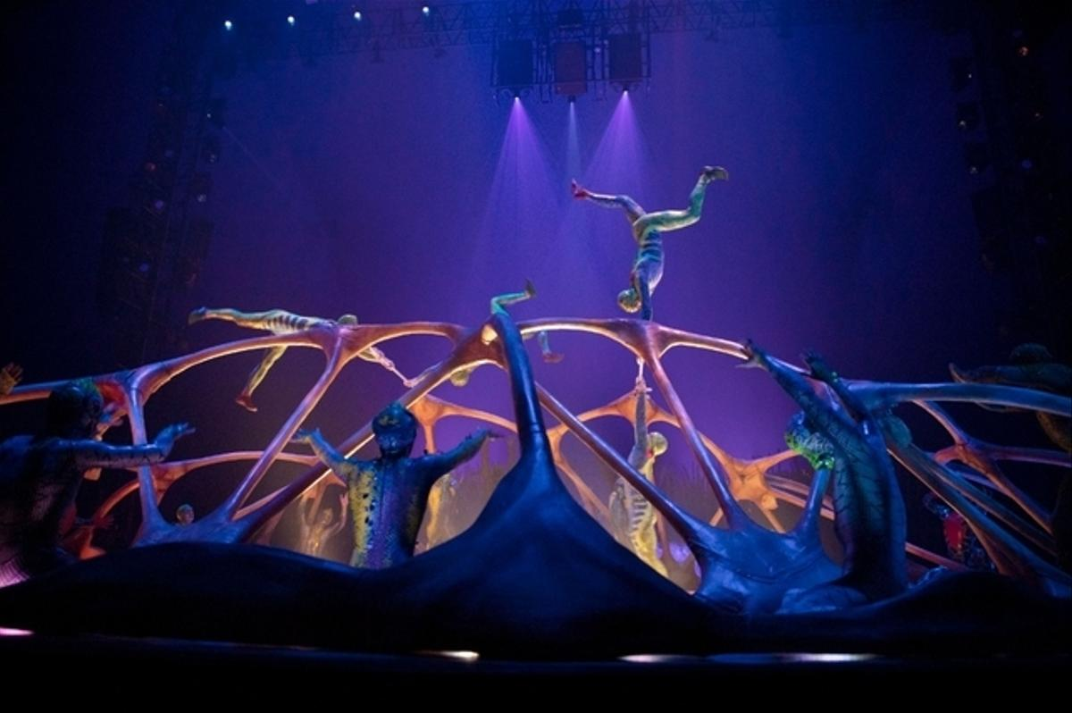
Past expansion plans
Overextension
Failures of expansion
Managerial issues

Slide 8
Expansion plans
Vertical Integration
Hold-up problem
Credibility
Complexities

Slide 9
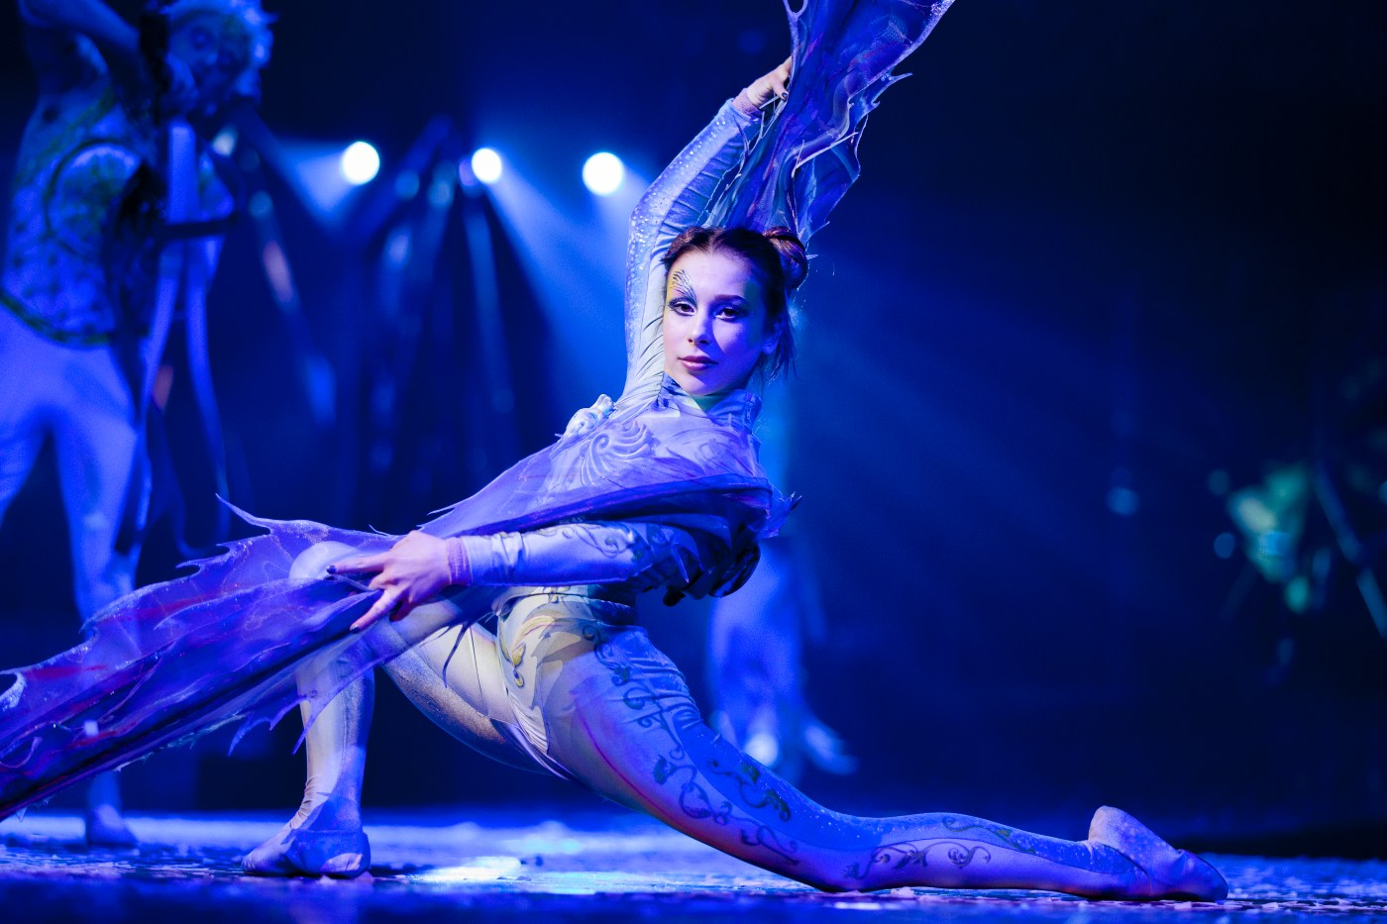
Expansions plans in Macao and Dubai
Promising projects
Non saturation of the entertainment market
Touristic places
Profitable in the long term

Slide 10
Expansions plans
Our general recommendations
Resident show
Touring show
New partnership with economic centers of Europe & Asia
Scaling down
High purchasing power customer segment
Accessible shows
Promotion
Increase tickets’ price
Decrease tickets’ price

Slide 11
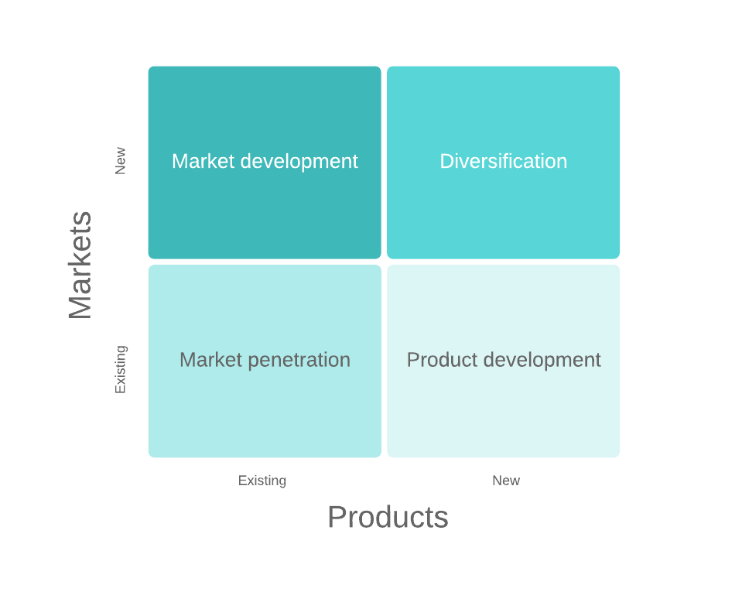
Ansoff matrix

Slide 12
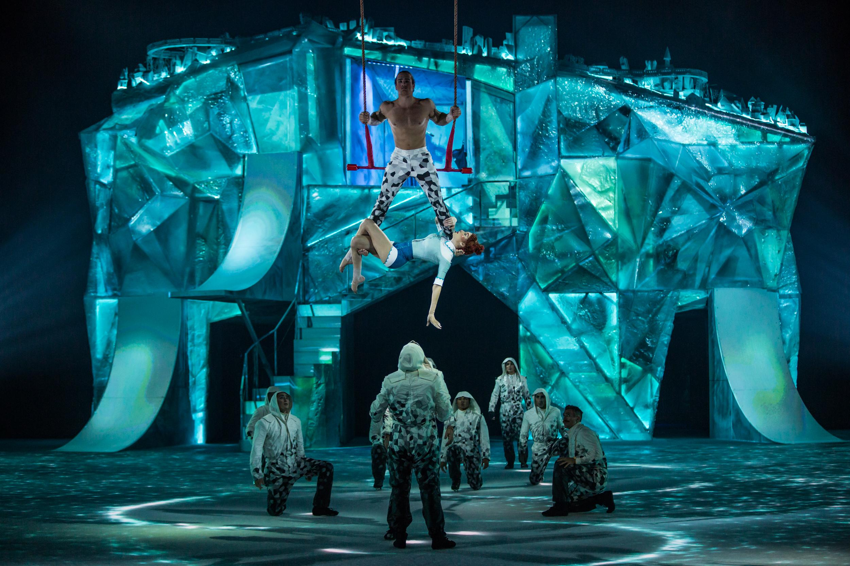
Conclusion
Creativity
Partnership with local hotels
Keep your shares

Slide 13
Thank you for your attention!

